Slide 1


Open Elective - Transportation Systems
Unit V
Prof. Yogesh S. Lanjewar
Assistant Professor
St. VINCENT PALLOTTI COLLEGE OF ENGINEERING &
TECHNOLOGY,NAGPUR
DEPARTMENT OF CIVIL ENGINEERING

Slide 2
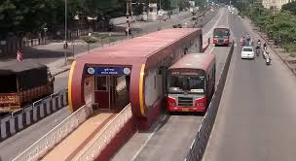
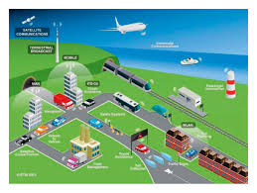
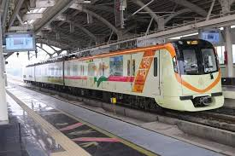
Modern Systems:
BRTS, Metro, Intelligent Transportation Systems and Case studies.

Slide 3
Contents
BRTS
ITS

Slide 4
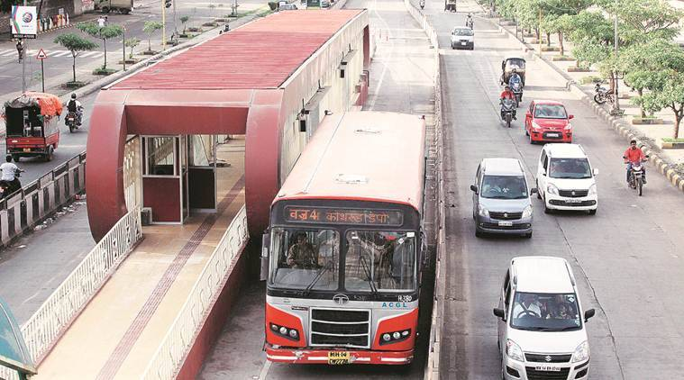
Bus Rapid Transit System (BRTS)
Definition from Federal Transit Administration: BRT is a high-capacity bus-based transit system that delivers fast and efficient service that may include dedicated lanes, busways, traffic signal priority, off-board fare collection, elevated platforms and enhanced stations

Slide 5
BRT or Busway or Transitway
Bus rapid transit (BRT), also referred to as a busway or transitway, is a bus-based public transport system designed to have much more capacity, reliability and other quality features than a conventional bus system.
Typically, a BRT system includes roadways that are dedicated to buses, and gives priority to buses at intersections where buses may interact with other traffic; alongside design features to reduce delays caused by passengers boarding or leaving buses, or paying fares.

Slide 6
BRT aims to combine the capacity and speed of a light rail or metro system (LRT) or heavy rail with the flexibility, lower cost and simplicity of a bus system.
The world's first BRT system was the Busway in Runcorn New Town, England, which entered service in 1971.
As of March 2018, a total of 166 cities in six continents have implemented BRT systems, accounting for 4,906 km (3,048 mi) of BRT lanes and about 32.2 million passengers every day.

Slide 7
Reasons for use
Compared to other common transit modes such as light rail transit (LRT), bus rapid transit (BRT) service is attractive to transit authorities because it does not cost as much to establish and operat.
No track needs to be laid, bus drivers typically require less training and less pay than rail operators,and bus maintenance is less complex than rail maintenance.
Moreover, buses are more flexible than rail vehicles, because a bus route can be altered, either temporarily or permanently, to meet changing demand or contend with adverse road conditions with comparatively little investment of resources.

Slide 8
Main features
Dedicated lanes and alignment
Off-board fare collection
Bus priority, turning and standing restrictions
Platform-level boarding
Additional features
High capacity vehicles
Quality stations
Prominent brand or identity
In tunnels or subterranean structures

Slide 9
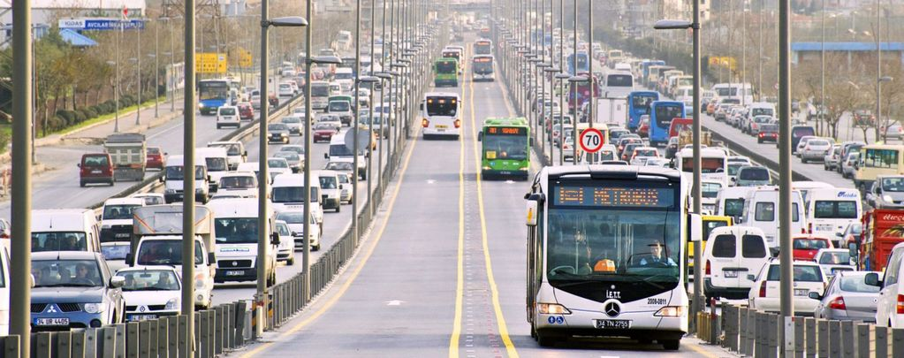

Slide 10
Intelligent transportation System
Intelligent transportation system (ITS) is the application of sensing, analysis, control and communications technologies to ground transportation in order to improve safety, mobility and efficiency.
Examples of intelligent transportation systems include:
Electronic toll collection.
V2X communication.
Intelligent traffic management.
Fleet management.
Electric vehicle charging.

Slide 11
An intelligent transportation system (ITS) is an advanced application which aims to provide innovative services relating to different modes of transport and traffic management and enable users to be better informed and make safer, more coordinated, and 'smarter' use of transport networks.
Some of these technologies include calling for emergency services when an accident occurs, using cameras to enforce traffic laws or signs that mark speed limit changes depending on conditions.

Slide 12
Defination As per Europian Union July 7, 2010
ITS defined as systems in which information and communication technologies are applied in the field of road transport, including infrastructure, vehicles and users, and in traffic management and mobility management, as well as for interfaces with other modes of transport.
ITS may be used to improve the efficiency and safety of transport in a number of situations, i.e. road transport, traffic management, mobility, etc.

Slide 13
Why Intelligent Transportation System needed?
Inadequate road development.
Low speed, increased accident rates.
It is not possible to build enough new roads or to meet the demand.
Make transportation system more efficient, secure, and safer through the use of information, communications and control technologies.
Improve the attractiveness of public transport.
Tackle rising congestion which increases travel times and industry costs.
Reduce the environmental impacts of transport.

Slide 14
Advantages of Intelligent Transportation System
Reduction in stops and delays at intersections.
Speed control & improvement.
Travel time improvement.
Capacity management.
Incident management.

Slide 15
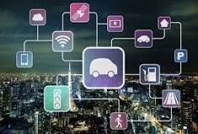
How Intelligent Transportation System Works?
1. ITS combining technologies
2. ITS Enabling Technologies
Data Acquisition
Data Processing
Data Communications
Data Distribution
Information Utilization
3. System Architecture

Slide 16
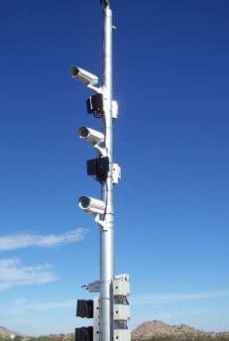
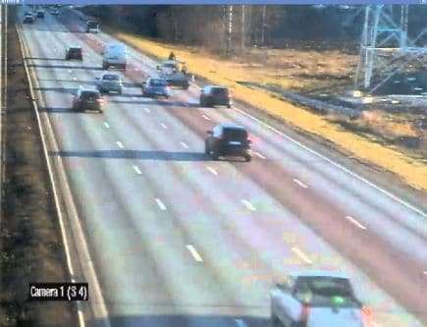
Data Acquisition Data Processing

Slide 17
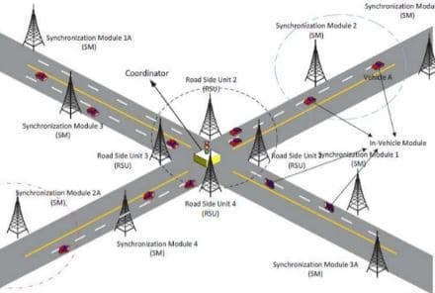
Data Communications

Slide 18
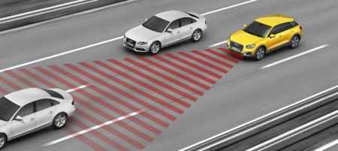
Information Utilization

Slide 19



